Slide 1


Math for Machine Learning
Linear algebra - Week 3
Vectors Matrices Dot product
Matrix multiplication Linear transformations

Slide 2











week 03

Slide 3
Vector Algebra

Slide 4






Vector Algebra

Slide 5
Vector Algebra

Slide 6







Linear Transformations

Slide 7
Linear Transformations

Slide 8
Linear Transformations

Slide 9
Linear Transformations

Slide 10












Linear Transformations

Slide 11









Neural Networks and Matrices

Slide 12
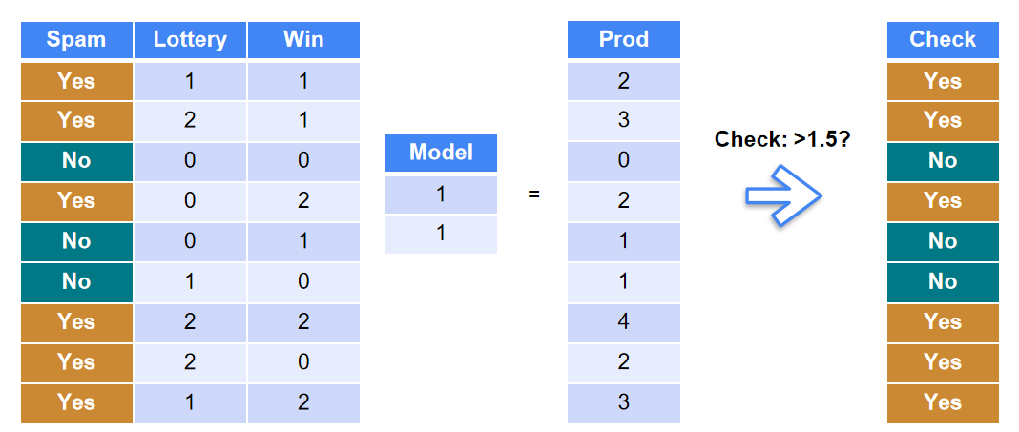
Neural Networks and Matrices

Slide 13







Neural Networks and Matrices

Slide 14







Neural Networks and Matrices

Slide 15
Neural Networks and Matrices

